Slide 1

Business operations analysis performed by Anna Zadorina
Jan. 2023
Rockbuster Stealth LLC
The Movie Rental Company

Slide 2


Project Overview
The management of the international movie rental chain “Rockbuster Stealth LLC” wants to learn more about its consumers to be competitive in the face of growing competition from Netflix and Amazon Prime.
Topics:
From where the revenue comes?
What are the most popular products in the portfolio, and how much the customers are ready to pay?
What is the average rental time and movie length?
Who are the top customers?

Slide 3




Facts and Figures*
Presented in 109 countries
Poses 599 customers
Rented 1000 movies
Total number of rentals 14 596
Generated revenue 61 312 04 USD
*Data from 2006

Slide 4
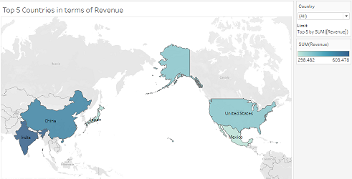
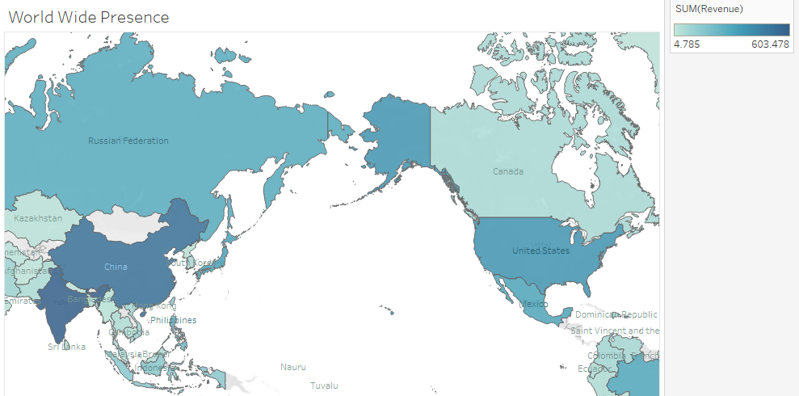
Knowing the Customers
From where the revenue comes?
Country Top 5 | Revenue in USD
India | 6034.78
China | 5251.03
United States | 3685.31
Japan | 3122.51
Mexico | 2984.82
Poses customers
from 109 counties
https://public.tableau.com/app/profile/zadorina.zadorina/viz/Countries_16743229519610/Sheet1?publish=yeshttps://public.tableau.com/app/profile/zadorina.zadorina/viz/CountriesandCustomers/Sheet1?publish=yes

Slide 5
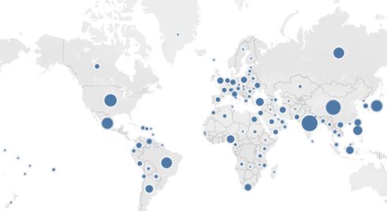
Knowing the Customers
From where the revenue comes?
USA
36 customers
Country | Number of customers | Payment per customer USD
India | 60 | 100,58
China | 53 | 99,08
United States | 36 | 102,37
Japan | 31 | 100,73
Mexico | 30 | 99,49
Mexico
30 Customers
Japan
31 customers
The table above demonstrates the Top 5 countries of origin of the customers, despite that, there are 2 customers from the Top 5 Customer Lists who live in other geographical regions: Turkey and the Philippines.
India
60 customers
China
53 customers
Who are the top customers?
Top 5 Customers List
customer id | first name | last name | city | country | total amount paid
84 | Sara | Perry | Atlixco | Mexico | 128.70
434 | Eddie | Tomlin | Ozamis | Philippines | 122.74
518 | Gabriel | Harder | Sivas | Turkey | 108.75
587 | Sergio | Stanfield | Celaya | Mexico | 102.76
537 | Clinton | Buford | Aurora | United States | 98.76
https://public.tableau.com/app/profile/zadorina.zadorina/viz/Countries_16743229519610/Sheet1?publish=yes
https://public.tableau.com/app/profile/zadorina.zadorina/viz/CountriesandCustomers/Sheet1?publish=yes

Slide 6
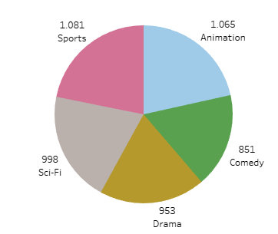
Popular Products
Top 5 the most popular Genres
Genre | Number of rentals
Sports | 1081
Sci-Fi | 998
Animation | 1065
Drama | 953
Comedy | 851
The renting length:
Minimum: 3 days
Maximum: 7 days
Not popular Genres: Travel, Music, Thriller
https://public.tableau.com/app/profile/zadorina.zadorina/viz/Geners_16743318125510/Sheet1?publish=yes
https://public.tableau.com/app/profile/zadorina.zadorina/viz/Movies_16743330792350/Sheet1?publish=yes

Slide 7
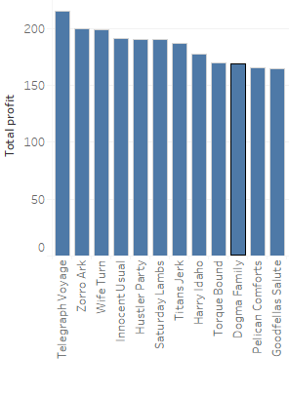
Popular Products
The products which brought the biggest amount of the Revenue
No. Rating | Film | Total profit
48 | Telegraph Voyage | 215,75
4 | Zorro Ark | 199,72
14 | Wife Turn | 198,73
26 | Innocent Usual | 191,74
131 | Hustler Party | 190,78
27 | Saturday Lambs | 190,74
15 | Titans Jerk | 186,73
16 | Harry Idaho | 177,73
91 | Torque Bound | 169,76
5 | Dogma Family | 168,72

Slide 8
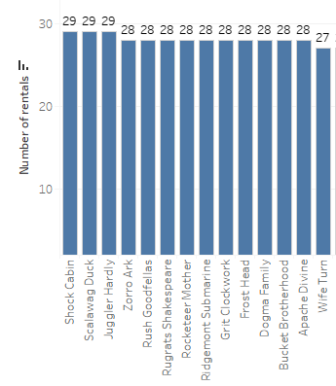
Popular Products
The most rented Movies
No. Rating | Film | Number of rentals
1 | Scalawag Duck | 29
2 | Shock Cabin | 29
3 | Juggler Hardly | 29
4 | Zorro Ark | 28
5 | Dogma Family | 28
6 | Apache Divine | 28
7 | Bucket Brotherhood | 28
8 | Ridgemont Submarine | 28
9 | Grit Clockwork | 28
10 | Rocketeer Mother | 28
As could be seen from previous
slide, the movies, which brought
the biggest amount of the revenue
were not the most demanding products

Slide 9
Conclusion
The majority of Rockbuster customers live in India, China, the United States, Japan, and Mexico - the top five nations in terms of revenue and customer coverage. Hence, Rockbuster shall take this information into consideration in order to plan further strategies.
In terms of revenue in 2006, the most popular genres were sports, science fiction, animation, drama, and comedy. The Thriller, which had only 11 rentals, has the lowest index. Since there is just one movie presented in this section, hence, that might be an error.
The rental length was about 5 days. The movies are rented in English.
The movies which brought the biggest amount of revenue weren’t the most rented movies, for example, Telegraph Voyage brought the biggest revenue, whereas it holds only 48 please in the rental frequency.
Based on the received results prepare promotions to invite new clients and increase the revenue from existing. Perform further client-oriented research and update data permanently.

Slide 10
Recommendations
During the research was distinguished, some categories do not provide a very vast variety of choices e.g Thriller. Therefore, it is suggested to study deeper customer preferences in order to diversify the product portfolio, add/remove some categories, and enrich the category content according to customers’ wishes.
The majority of movies are presented in English, thus the company has a global presence. Nevertheless, there are many clients from non-English-speaking countries such as Mexico, hence, the marketing team might be interested in providing more language options that will be lucrative to the clients from other regions e.g Spanish-speaking market. Therefore, the data analytics team needs to make research in chosen markets if there is a such necessity because, maybe the clients use Rockbuster Stealth LLC as a source for movies in English for study purposes, for example.
Study the more precisely buying behavior of the top 5-10 customers from the top Customer list in order to make Client-oriented products, maybe the experience from those users might be valuable and transferable to other clients. Understand why those clients prefer the Rockbuster Stealth LLC platform as the main source of entertainment.

